Slide 1
Unit 3 Virtualization and Resource Management

Slide 2
Syllabus
Basics of Virtualization
Types of Virtualizations: Compute, Storage, and Network
Hypervisors: Type 1 & Type 2
Virtual Machines vs. Containers
Docker and Kubernetes Overview
Resource Allocation and Load Balancing.

Slide 3
Virtualization
Virtualization is the fundamental technology that powers Cloud Computing.
It allows you to create multiple simulated environments (Virtual Machines or VMs) from a single physical hardware system.
Before virtualization, a physical server could only run one Operating System (OS) and often one task. This wasted massive amounts of resources if your app only used 10% of the CPU, the other 90% was idle.
Virtualization solves this by allowing one physical server to host dozens of virtual servers, each running its own OS and apps isolated from the others.

Slide 4
Characteristics of Virtualization
Virtualization is a foundational technology in modern computing as it offers a range of crucial features that enhance IT flexibility and efficiency.
Here are the most notable characteristics of virtualization:
Instance isolation. Virtualization isolates all virtual instances present on the server. Each environment operates independently and securely without interference from other instances.
Hardware abstraction. Virtualization abstracts physical hardware resources into virtual instances. Abstraction allows admins and end-users to manage resources independently of the underlying hardware.
Resource pooling. Virtualization enables the pooling of physical resources from multiple hardware devices into a shared resource pool. That way, instances can meet demands that exceed the capabilities of a single device.

Slide 5
State encapsulation. Virtualization encapsulates the entire state of a virtual instance into files or images. This feature makes instances easy to replicate.
Hardware independence. Abstraction of underlying hardware allows VMs to run on different types of physical infrastructure without requiring modifications. Hardware independence makes it simple to migrate VMs between different providers or IT environments.
Dynamic provisioning. Virtualization enables dynamic provisioning and scaling of instances. You can allocate or deallocate resources in real time based on current requirements, eliminating the need to manage hardware.
Resource scalability. Virtualization allows users to easily scale instances. Users get to scale both vertically (i.e., by adding more resources to existing instances) and horizontally (i.e., by deploying more instances).

Slide 6
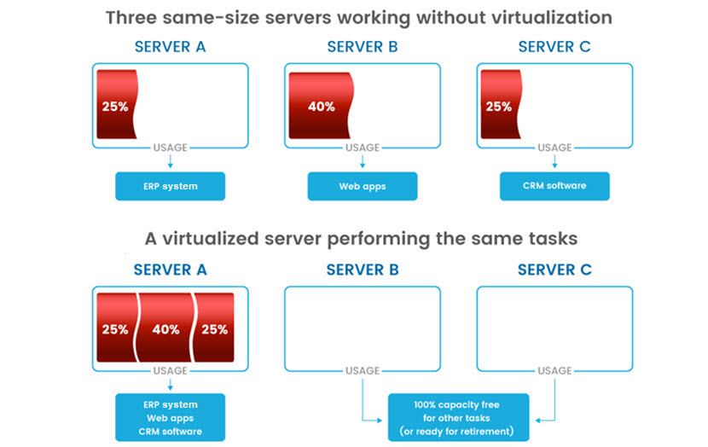

Slide 7
Types of Virtualization
Abstracting servers into multiple VMs is just one of several virtualization strategies companies use to streamline operations. Below are five other common types of virtualization that boost IT efficiency and cost-effectiveness.
Storage Virtualization
Network Virtualization
Data Virtualization
App Virtualization
Desktop Virtualization

Slide 8
Storage Virtualization
Storage virtualization abstracts physical storage resources (hard drives, SSDs, storage arrays, etc.) from the underlying hardware, allowing admins to manage them as a single pool of storage. Virtualized storage pools operate as a cohesive storage resource, which enables:
More efficient use of storage capacity.
Streamlined archiving, backup, and recovery procedures.
Simplified storage management.
Simpler data migrations.

Slide 9
Virtualizing storage enables the integration of devices from different vendors and disparate locations into a unified storage infrastructure. This integration maximizes existing investments and helps avoid vendor lock-in.
Storage virtualization also often includes thin provisioning capabilities, which allow admins to allocate storage capacity on demand rather than pre-allocating physical storage space. Thin provisioning helps optimize storage utilization and reduce waste.

Slide 10
Network Virtualization
Network virtualization abstracts network resources to enable the creation of multiple virtual networks on top of a shared physical infrastructure.
Admins control abstracted resources without having to manage the underlying hardware, which dramatically simplifies network management.

Slide 11
Each virtual network operates as a logically separate entity with individual network policies, address space, and configurations. Traffic from one virtual network cannot directly access or interfere with traffic from another virtual network.
There are two types of network virtualization:
Software-defined networking (SDN). SDN virtualizes the control plane (which determines how traffic is forwarded) and decouples it from the data plane (which actually forwards traffic). Software-defined control planes instruct hardware on how to direct traffic, which makes networks easier to manage.
Network Function Virtualization (NFV). NFV virtualizes network appliances (routers, firewalls, load balancers, etc.) and turns them into software-based instances. NFV makes network appliances easier to configure, provision, and manage.

Slide 12
Network virtualization is vital for hybrid and multi-cloud connectivity. The tech enables seamless connections and workload mobility between on-prem and cloud-based resources, both of which are crucial to multi and hybrid cloud architecture.

Slide 13
Data Virtualization
Data virtualization abstracts and integrates data from different databases, data warehouses, and services.
As a result, you abstract the physical location, format, and structure of data from underlying data sources, presenting it in a logical, unified view to users and apps.
Data virtualization simplifies data storage and retrieval complexities, making data easier to access and utilize. This type of virtualization also makes it simple to integrate data from disparate sources, including:
Different database types.
Web services.
Flat files.
Cloud storage platforms.

Slide 14
Data virtualization also often includes aggregation, transformation, and enrichment of on-the-fly data. These features allow users to combine and manipulate data from different sources to meet specific business needs.

Slide 15
App Virtualization
App virtualization abstracts software apps from the underlying OS and encapsulates them into self-contained packages that run in isolation from the host environment. Virtualized packages contain everything the app needs to run, including all the necessary files, libraries, and dependencies.
Each virtualized app operates within a sandbox to prevent conflicts with other apps and system configurations. As a result, app virtualization helps resolve compatibility issues. For example, you can use this type of virtualization to run a Windows app on Linux or vice versa.

Slide 16
There are three types of app virtualization:
Local app virtualization. In this approach, the entire app runs in a runtime environment on the endpoint device. Users install and execute the app locally, but the app operates within a virtualized environment isolated from the OS and other programs.
App streaming. In this method, the app resides on a server that streams small software components or necessary data to the endpoint device. As a result, the app executes on the endpoint without requiring a complete install, reducing the resource requirements on the device.
Server-based app virtualization (or app publishing). In this approach, the app runs entirely on a server or remote infrastructure. The server only transmits the app's user interface elements to the client device via a web browser or client interface.

Slide 17
Virtualized apps consume fewer system resources compared to traditional installations.
These apps do not require users to modify system files or registry settings on incompatible devices, which leads to improved performance on host systems.

Slide 18
Desktop Virtualization
Desktop virtualization, also known as Virtual Desktop Infrastructure (VDI), involves hosting virtual desktops on a centralized server and delivering them to end-user devices over a local network or the Internet.
Instead of running desktop OSes and apps locally on their devices, users access virtual desktops remotely via PCs, laptops, tablets, or smartphones. This accessibility enhances mobility and enables remote work, allowing users to securely access virtual desktops from home, on the road, or in branch offices.

Slide 19
A virtualized desktop can be either persistent or non-persistent:
Persistent desktops retain settings, files, and apps across sessions.
Non-persistent desktops discard all changes made during the session after logout, providing a clean slate for the next user.
Desktop virtualization centralizes management tasks such as provisioning, patching, updating, and backups. Admins manage virtual desktops from a central console, making it easier to maintain consistency and security across all environments.

Slide 20
Virtualization Advantages and Disadvantages
Like all technologies, virtualization has both pros and cons you must know about before you start virtualizing parts of your IT infrastructure. Let's take a closer look at the main advantages and disadvantages of virtualization.

Slide 21
Advantages
Virtualization offers many benefits that drive IT efficiency and agility. By decoupling computing resources from hardware, virtualization transforms IT environments into dynamic, flexible, and cost-effective ecosystems.
Here are the main benefits of using virtualization:
Centralized management. Virtualization centralizes management tasks such as provisioning, monitoring, and maintenance. Admins manage VMs through a unified interface or software-defined control plane, which streamlines administration and reduces operational complexity.
Improved resource utilization. An average dedicated server uses only 15% of its resources during normal operation. Virtualization enables you to run multiple VMs on a single server, maximizing the use of each server's capacity.

Slide 22
High scalability. Virtualization enables rapid scaling of IT infrastructure to accommodate changing workload demands. This agility supports business growth and fluctuations in resource requirements.
Cost savings. Virtualization significantly reduces hardware costs by consolidating multiple VMs onto fewer physical servers. Adopters get to lower hardware acquisition costs and reduce maintenance expenses.
Faster provisioning. Buying, installing, and configuring physical hardware is time-consuming. On the other hand, provisioning VMs is quick and easy, plus it can be done automatically.

Slide 23
Improved security. Virtualization enhances security by isolating VMs from each other and the underlying hardware. As a result, adopters reduce the risk of malware infections, data breaches, and unauthorized access.
Workload portability. Virtualized environments are platform-independent. VMs seamlessly run on different hardware platforms and migrate between on-prem and cloud environments.
Reduced downtime. VMs move between physical hosts with minimal downtime, which makes it easier to ensure the availability of critical services. You can run multiple redundant VMs alongside each other and set up failover between them to ensure zero downtime during disruptive incidents.

Slide 24
Disadvantages
While virtualization offers numerous benefits, the tech introduces a few drawbacks you must consider before adoption.
Here are the main disadvantages of virtualization:
Performance overhead. The additional layer of abstraction between VMs and physical hardware introduces a slight performance overhead. This overhead can impact performance if you run resource-intensive workloads.
New attack vectors. While beneficial to overall security, virtualization introduces a few new attack vectors. Adopters must account for VM escape vulnerabilities, hypervisor exploits, and guest-to-guest attacks.
Resource contention. Virtualized systems can suffer from bottlenecks when VMs compete for shared resources. One VM monopolizing resources and impacting the performance of other VMs is a common issue if the adopter does not properly set up resource allocation.

Slide 25
Storage overhead. VMs require disk space for storing virtual disks (VMDKs, VHDs, etc.) and snapshots, which introduces some storage overhead. Managing virtual storage resources requires careful planning to avoid sprawl and inefficiencies.
Vendor lock-in. Organizations may become overly dependent on specific virtualization vendors and technologies. This vendor lock-in makes switching between platforms or migrating VMs to alternative solutions complex and costly.
Shadow IT. Employees may deploy VMs without proper authorization or oversight from the security team. These shadow IT instances consume resources and often introduce new risks.

Slide 26
Reference
https://phoenixnap.com/blog/cloud-virtualization

Slide 27
Compute Virtualization
Compute virtualization is a technology that involves abstracting and isolating computer resources, enabling multiple operating systems and applications to run concurrently on a single physical machine.
This process is achieved through a virtualization software, commonly known as a hypervisor, which manages and allocates the underlying hardware resources to the virtual instances.
As a result, compute virtualization increases efficiency, flexibility, and resource utilization within IT environments.

Slide 28
Key Characteristics
Compute Virtualization allows multiple operating systems and applications to run on the same physical hardware, significantly improving hardware utilization and reducing overall IT costs.
It improves resource allocation, flexibility, and management by allowing resources such as CPU, memory, and storage to be pooled and dynamically assigned to virtual machines as needed.
Virtualization enhances system performance and security by isolating virtual machines from one another, enabling faster deployment of new applications, simplified disaster recovery, and secure multi-tenancy.

Slide 29
Main Components of Virtualization
1. Hypervisor: Software that enables virtualization by running multiple OS on one physical machine.
2. Virtual Machine (VM): A software-based emulation of a physical computer.
3. Host Machine: The physical computer providing resources for virtualization.
4. Guest OS: The operating system installed inside a virtual machine.
5. vCPU: Virtual CPU assigned to a VM, mapped to physical CPU cores.
6. Virtual Network: A software-defined network connecting VMs internally or externally.

Slide 30
Hypervisor
A hypervisor (or Virtual Machine Monitor, VMM) is software that lets multiple operating systems run on a single physical machine.
It manages hardware resources (CPU, memory, storage) and allocates them to virtual machines (VMs) without interference.
This improves hardware utilization, reduces costs, and provides flexibility in cloud and server environments.

Slide 31
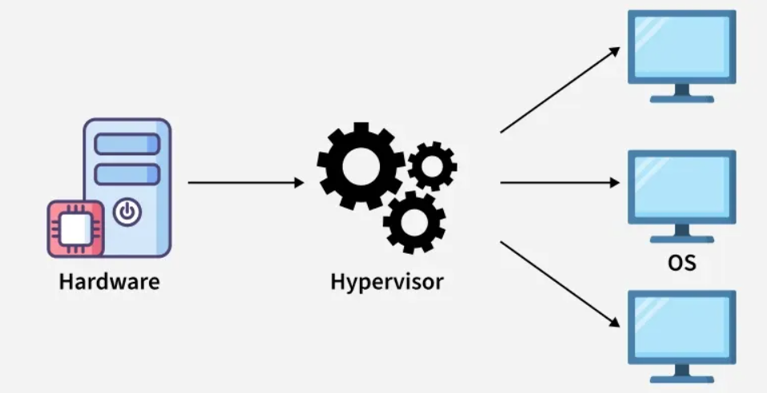
A hypervisor runs on hardware or a host OS to create and manage virtual machines (VMs), each with its own virtual CPU, memory, storage, and network.
It intercepts guest OS requests and translates them to physical hardware, ensuring isolation, security, and stability.

Slide 32
Types of Hypervisor
There are two main types of hypervisors, each with a different architecture:
Type 1 Hypervisor(bare-metal)
Type 2 Hypervisor(Hosted)

Slide 33
Type 1 Hypervisor(bare-metal)
A Type 1 hypervisor runs directly on the host's hardware.
It doesn't rely on a host operating system.
This architecture offers better performance and security because there is no intermediary OS.
It's the standard for enterprise-level data centers and cloud providers like Amazon Web Services (AWS) and Microsoft Azure.
Examples: VMware ESXi, Microsoft Hyper-V, KVM (Kernel-based Virtual Machine), and Xen.

Slide 34
Pros:
High performance (direct hardware access).
Strong security (no intermediate OS layer).
Suitable for mission-critical workloads.
Cons:
Requires dedicated hardware.
Setup and management are complex compared to Type-2.

Slide 35
Type 2 Hypervisor(Hosted)
A Type 2 hypervisor runs on top of a conventional operating system (like Windows, macOS, or Linux).
It's essentially an application within the host OS.
This type is generally used for desktop virtualization, development, and testing environments where a user needs to run multiple OSs on their personal computer.
Performance is slightly lower than Type 1 due to the overhead of the host OS.
Examples: Oracle VM VirtualBox, VMware Workstation, and Parallels Desktop.

Slide 36
Pros:
Easy to install and use.
Useful for development, testing, and malware analysis.
Provides good host–guest integration features.
Cons:
Slower performance (no direct hardware access).
Security depends on the host OS; compromise of host may affect guests.

Slide 37
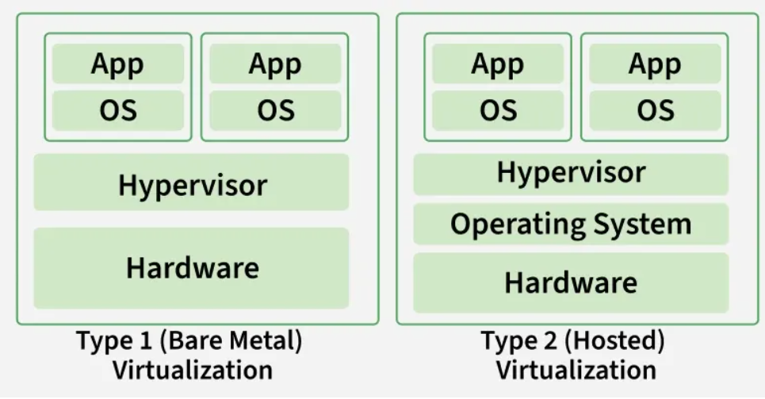

Slide 38
HYPERVISOR REFERENCE MODEL
There are 3 main modules coordinates in order to emulate the underlying hardware:
DISPATCHER: The dispatcher behaves like the entry point of the monitor and reroutes the instructions of the virtual machine instance to one of the other two modules.
ALLOCATOR: The allocator is responsible for deciding the system resources to be provided to the virtual machine instance. It means whenever a virtual machine tries to execute an instruction that results in changing the machine resources associated with the virtual machine, the allocator is invoked by the dispatcher.
INTERPRETER: The interpreter module consists of interpreter routines. These are executed, whenever a virtual machine executes a privileged instruction.

Slide 39
Virtual Machines vs. Containers
Containers and virtual machines are technologies that make your applications independent from your IT infrastructure resources.
A container is a software code package containing an application’s code, its libraries, and other dependencies.
Containerization makes your applications portable so that the same code can run on any device.
A virtual machine is a digital copy of a physical machine.
You can have multiple virtual machines with their own individual operating systems running on the same host operating system.
In addition you can create a virtual machine that contains everything required to run your application.

Slide 40
Where are containers and virtual machines used?
Containers and virtual machines are both deployment technologies.
In the software development lifecycle, deployment is the mechanism that makes an application run efficiently on a server or device.
The application requires several additional software components called dependencies that are closely related to the underlying operating system of the server.
All these different software layers between the application code and the physical device are called the application environment.

Slide 41
Challenges in software deployment
Organizations typically have to deploy applications in multiple environments—for example, developing on the Linux environment and testing on Windows—before releasing new features.
Moving the application between environments can result in bugs and glitches, which lower productivity, due to missed dependencies.
At the same time, building and testing the application in just one environment limits its usefulness.

Slide 42
Here are some examples:
You may have to develop different versions for users with different operating systems
Your system administrators must update and maintain all environments uniformly, increasing development costs
You may find it challenging to move your applications from on-premises data centers to the cloud or between different cloud environments

Slide 43
Purpose of virtual machines
Historically, virtual machine technology was developed to efficiently use increasing physical hardware capacity and processing power.
Running a single application environment on a single physical server underutilized hardware resources.
Virtual machines allow organizations to install multiple operating systems and create multiple environments on the same physical machine.

Slide 44
Purpose of containers
Containers were created to package and run applications in a predictable and repeatable way across multiple environments.
Instead of recreating the environment, you packaged the application to run on all types of physical or virtual environments.
This is similar to putting an astronaut in a spacesuit instead of recreating the Earth's atmosphere for them on another planet.

Slide 45
Similarities between containers and virtual machines
Containers and virtual machines allow for the full isolation of applications so that you can run them in multiple environments.
They virtualize or abstract underlying infrastructure, so users don't have to worry about that.
They also allow you to package your software infrastructure into a single file called an image file. You can use the image file to quickly set up and run your application anywhere.
However, the role and extent of use for containers and virtual machines vary depending on where and how the application is deployed.

Slide 46
Key differences: containers vs. virtual machines
Containers virtualize the operating system so the application can run independently on any platform.
Virtual machines go beyond that to virtualize physical machines, so you can use your hardware resources efficiently.

Slide 47
How they work
Container technology involves building self-sufficient software packages that perform consistently, regardless of the machines they run on. Software developers create and deploy container images—files containing the necessary information to run the application. Container images are read-only and cannot be altered by the computer system.
Virtual machine technology involves installing virtualization software on a physical server or computer. The physical computer is called the host computer and the virtual machine is called the guest. You can configure and update the guest operating system and its applications as necessary without affecting the host operating system.

Slide 48
Core technology
Virtual machines use hypervisors that communicate between the guest operating system and the host operating system. The hypervisor coordinates resource sharing, so the virtual machine runs in isolation alongside several others on the same hardware.
Containers, on the other hand, use a container engine or container runtime. This is software that acts as an intermediary agent between the containers and the operating system, providing and managing system resources that the application needs. Docker is the most popular open-source container engine.

Slide 49
Size
Virtual machine image files are larger in size (several GB) as they contain their own operating system. Increased resources mean you can duplicate, split, abstract, and emulate entire servers, databases, desktops, and networks.
Container files are more lightweight, and you can measure them in MB. Containers only package the resources required to run a single application.

Slide 50
When to use containers vs. virtual machines
Here, we give some factors to consider when choosing between virtual machines and containers for application deployment.
Environment configuration
Virtual machines give developers more control over the application's environment. They can manually install system software, snapshot configuration states, and restore them to a previous state if required. They are useful for ideation and experimentation or for testing different environments to improve an application's performance.
Containers provide static definitions of configurations once the best ones have been selected.

Slide 51
Software development speed
Virtual machines are full-stack systems and can be laborious to build and regenerate. Any modifications are time-consuming to validate as you have to regenerate the environment.
Containers are a better choice if you want to build, test, and release new features frequently. As they only include high-level software, they are very fast to modify and iterate on.

Slide 52
Scalability
Virtual machines take up more storage space and require you to provision more hardware in your on-premises data centers. Switching to cloud instances reduces costs but migrating your entire environment brings its own challenges.
Containers take up less space and are easier to scale. More importantly, containers provide granular control on application scalability by allowing you to use microservices. Microservices are an architectural and organizational approach to software development where software is composed of small independent services that communicate over well-defined APIs. Containers let you scale individual microservices as required.

Slide 53
Summary of differences: container vs. virtual machine
Characteristics | Container | Virtual machine
Definition | Software code package containing an application’s code, its libraries, and other dependencies that make up the application running environment. | Digital replica of a physical machine. Partitions the physical hardware into multiple environments.
Virtualization | Virtualizes the operating system. | Virtualizes the underlying physical infrastructure.
Encapsulation | Software layer above the operating system required for running the application or application component. | Operating system, all software layers above it, multiple applications.
Technology | Container engine coordinates with the underlying operating system for resources. | Hypervisor coordinates with underlying operating system or hardware.

Slide 54
Characteristics | Container | Virtual machine
Size | Lighter weight (think in terms of MB). | Much larger (think in terms of GB).
Control | Less control of the environment outside the container. | More control over the entire environment.
Flexibility | More flexible. You can quickly migrate between on-premises and cloud-centered environments. | Less flexible. Migration has challenges.
Scalability | Highly scalable. Granular scalability possible with microservices. | Scaling can be costly. Requires switching from on-premises to cloud instances for cost-effective scale.

Slide 55
Ref: https://aws.amazon.com/compare/the-difference-between-containers-and-virtual-machines/

Slide 56
Docker and Kubernetes Overview
Docker is a tool used to containerize your application, i.e. it packs the required code along with the dependencies required to operate an application.
It has proved to be a boon for the software development field as it works on any machine.
Basically, an application needs various dependencies when it is being developed to function properly, and developers often face errors in running the code which may be related to his/her system.

Slide 57
It is imperative to make changes and rectifications in the required places in order to go forward.
This may affect the code and there might be chances that the application will only work on that particular machine because of which the application does not start when the code is passed and the debugging of errors on the other machine can become a cumbersome task.

Slide 58
Docker saves you from all these hassles as it runs your application in an isolated environment called containers under which you can install all the required dependencies.
After that, you can create an image of that container and push it to the docker-hub (Similar to GitHub, wherein we maintain our code repository).
The derived image is like a blueprint of the container's dependencies which you can share with your project partners without any hassle.

Slide 59
Kubernetes
The name Kubernetes originates from Greek, meaning helmsman or pilot.
K8s as an abbreviation results from counting the eight letters between the "K" and the "s".
Google open sourced the Kubernetes project in 2014.
Kubernetes combines over 15 years of Google's experience running production workloads at scale with best-of-breed ideas and practices from the community.

Slide 60
Kubernetes is a portable, extensible, open source platform for managing containerized workloads and services that facilitate both declarative configuration and automation.
It has a large, rapidly growing ecosystem.
Kubernetes services, support, and tools are widely available.

Slide 61
Why you need Kubernetes and what it can do
Containers are a good way to bundle and run your applications. In a production environment, you need to manage the containers that run the applications and ensure that there is no downtime. For example, if a container goes down, another container needs to start. Wouldn't it be easier if this behavior was handled by a system?
That's how Kubernetes comes to the rescue! Kubernetes provides you with a framework to run distributed systems resiliently. It takes care of scaling and failover for your application, provides deployment patterns, and more. For example: Kubernetes can easily manage a canary deployment for your system.

Slide 62
Kubernetes provides you with:
Service discovery and load balancing Kubernetes can expose a container using a DNS name or its own IP address. If traffic to a container is high, Kubernetes is able to load balance and distribute the network traffic so that the deployment is stable.
Storage orchestration Kubernetes allows you to automatically mount a storage system of your choice, such as local storage, public cloud providers, and more.
Automated rollouts and rollbacks You can describe the desired state for your deployed containers using Kubernetes, and it can change the actual state to the desired state at a controlled rate. For example, you can automate Kubernetes to create new containers for your deployment, remove existing containers and adopt all their resources to the new container.

Slide 63
Automatic bin packing You provide Kubernetes with a cluster of nodes that it can use to run containerized tasks. You tell Kubernetes how much CPU and memory (RAM) each container needs. Kubernetes can fit containers onto your nodes to make the best use of your resources.
Self-healing Kubernetes restarts containers that fail, replaces containers, kills containers that don't respond to your user-defined health check, and doesn't advertise them to clients until they are ready to serve.
Secret and configuration management Kubernetes lets you store and manage sensitive information, such as passwords, OAuth tokens, and SSH keys. You can deploy and update secrets and application configuration without rebuilding your container images, and without exposing secrets in your stack configuration.

Slide 64
Batch execution In addition to services, Kubernetes can manage your batch and CI workloads, replacing containers that fail, if desired.
Horizontal scaling Scale your application up and down with a simple command, with a UI, or automatically based on CPU usage.
IPv4/IPv6 dual-stack Allocation of IPv4 and IPv6 addresses to Pods and Services
Designed for extensibility Add features to your Kubernetes cluster without changing upstream source code.

Slide 65
What Kubernetes is not
Kubernetes is not a traditional, all-inclusive PaaS (Platform as a Service) system.
Since Kubernetes operates at the container level rather than at the hardware level, it provides some generally applicable features common to PaaS offerings, such as deployment, scaling, load balancing, and lets users integrate their logging, monitoring, and alerting solutions.
However, Kubernetes is not monolithic, and these default solutions are optional and pluggable.
Kubernetes provides the building blocks for building developer platforms, but preserves user choice and flexibility where it is important.

Slide 66
Kubernetes:
Does not limit the types of applications supported. Kubernetes aims to support an extremely diverse variety of workloads, including stateless, stateful, and data-processing workloads. If an application can run in a container, it should run great on Kubernetes.
Does not deploy source code and does not build your application. Continuous Integration, Delivery, and Deployment (CI/CD) workflows are determined by organization cultures and preferences as well as technical requirements.

Slide 67
Does not provide application-level services, such as middleware (for example, message buses), data-processing frameworks (for example, Spark), databases (for example, MySQL), caches, nor cluster storage systems (for example, Ceph) as built-in services. Such components can run on Kubernetes, and/or can be accessed by applications running on Kubernetes through portable mechanisms, such as the Open Service Broker.
Does not dictate logging, monitoring, or alerting solutions. It provides some integrations as proof of concept, and mechanisms to collect and export metrics.
Does not provide nor mandate a configuration language/system (for example, Jsonnet). It provides a declarative API that may be targeted by arbitrary forms of declarative specifications.

Slide 68
Does not provide nor adopt any comprehensive machine configuration, maintenance, management, or self-healing systems.
Additionally, Kubernetes is not a mere orchestration system. In fact, it eliminates the need for orchestration. The technical definition of orchestration is execution of a defined workflow: first do A, then B, then C. In contrast, Kubernetes comprises a set of independent, composable control processes that continuously drive the current state towards the provided desired state. It shouldn't matter how you get from A to C. Centralized control is also not required. This results in a system that is easier to use and more powerful, robust, resilient, and extensible.

Slide 69
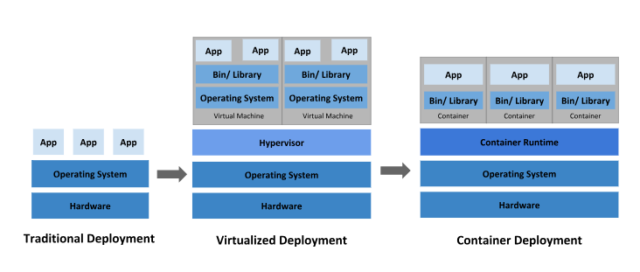
Historical context for Kubernetes

Slide 70
Traditional deployment era:
Early on, organizations ran applications on physical servers.
There was no way to define resource boundaries for applications in a physical server, and this caused resource allocation issues.
For example, if multiple applications run on a physical server, there can be instances where one application would take up most of the resources, and as a result, the other applications would underperform.
A solution for this would be to run each application on a different physical server. But this did not scale as resources were underutilized, and it was expensive for organizations to maintain many physical servers.

Slide 71
Virtualized deployment era:
As a solution, virtualization was introduced. It allows you to run multiple Virtual Machines (VMs) on a single physical server's CPU. Virtualization allows applications to be isolated between VMs and provides a level of security as the information of one application cannot be freely accessed by another application.
Virtualization allows better utilization of resources in a physical server and allows better scalability because an application can be added or updated easily, reduces hardware costs, and much more. With virtualization you can present a set of physical resources as a cluster of disposable virtual machines.
Each VM is a full machine running all the components, including its own operating system, on top of the virtualized hardware.

Slide 72
Container deployment era:
Containers are similar to VMs, but they have relaxed isolation properties to share the Operating System (OS) among the applications. Therefore, containers are considered lightweight.
Similar to a VM, a container has its own filesystem, share of CPU, memory, process space, and more.
As they are decoupled from the underlying infrastructure, they are portable across clouds and OS distributions.

Slide 73
https://kubernetes.io/docs/concepts/overview/#why-you-need-kubernetes-and-what-can-it-do
https://kubernetes.io/docs/concepts/overview/#why-you-need-kubernetes-and-what-can-it-do

Slide 74
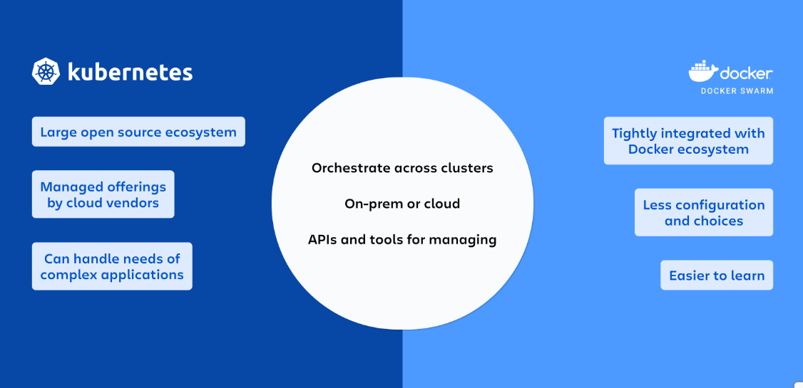

Slide 75
Kubernetes Vs. Docker: Complementary, Not Competitors
Docker and Kubernetes are often positioned as competitors, but they’re not. This misconception arises from the overlapping functionalities they offer for containerization. While they both deal with containers, they serve different purposes in the development pipeline.
Docker is a platform that simplifies the management of application processes in containers and automates the deployment of applications inside lightweight and portable containers. Kubernetes, by contrast, is a container orchestration platform. Rather than building or deploying containers, Kubernetes coordinates, schedules, and manages already-created containers.
Many organizations use Docker to create and manage containers and Kubernetes for orchestration. Docker and Kubernetes provide complementary technologies that work together to provide a complete solution for deploying, scaling, and managing containerized applications.

Slide 76
Serving Complementary Containerization Roles
Docker and Kubernetes serve complementary roles in the containerization ecosystem. They work together to facilitate containerized applications' development, deployment, and management.
Docker specializes in packaging applications into containers, encapsulating the application’s code, runtime environment, libraries, and dependencies in a single, portable unit. It creates Docker images that developers can share to deploy their applications across any system that supports Docker.

Slide 77
Once applications are containerized using Docker, Kubernetes manages their deployment across a cluster of machines. It uses Docker to run containers but extends its capabilities by automating container scheduling, load balancing, auto scaling, and self-healing. Kubernetes allows for easy application deployment from Docker images, managing their lifecycle at scale and providing the infrastructure to deploy Docker containers reliably in production environments.
Together, Docker and Kubernetes offer a comprehensive solution for containerized applications. Docker streamlines the containerization and distribution of applications, while Kubernetes provides the infrastructure to run them efficiently across a distributed computing environment.

Slide 78
Use Cases and Applications for Docker and Kubernetes
Docker and Kubernetes are commonly used together, but there are other use cases where one is a better fit than the other.
Use Cases Where Docker Is Preferred
Docker is preferred in scenarios requiring rapid application development and deployment. Its lightweight containerization technology is ideal for microservices architectures, where each service can be developed, deployed, and scaled independently.

Slide 79
Use Cases Where Kubernetes Is Better
Kubernetes excels in managing complex, large-scale applications across multiple containers and hosts. It's ideal for environments requiring high availability.
Kubernetes is better for orchestrating microservices architectures, ensuring seamless communication and deployment.
It suits cloud-native applications that benefit from auto-scaling and self-healing capabilities.
Enterprises seeking to deploy applications across hybrid or multicloud environments often choose Kubernetes.

Slide 80
How Docker and Kubernetes Can Be Used Together
E-commerce Platforms
Docker creates lightweight containers for e-commerce microservices-based architectures, allowing for rapid deployment and testing of new features. With Kubernetes, microservices can be automatically scaled during high-traffic events.

Slide 81
Healthcare Organizations
Docker packages patient data processing applications, ensuring compliance with strict regulatory standards by maintaining a consistent and secure environment across development and production. Kubernetes orchestration allows these applications to scale in response to fluctuating data processing loads.

Slide 82
Technology Industry
Technology companies use Docker and Kubernetes to host CI/CD pipelines to automate the build, test, and deployment processes. Kubernetes' self-healing and rollback capabilities ensure that the deployment process is efficient and resilient, minimizing downtime and speeding up development cycles.

Slide 83
Load balancing in Cloud Computing
Cloud load balancing is the method of distributing workloads and computing properties across multiple resources (such as servers, virtual machines, or containers).
As internet traffic continues to grow rapidly (historically doubling annually), managing workload demands is critical.
Load balancing ensures no single resource is overburdened, improving overall performance, availability, and scalability.

Slide 84
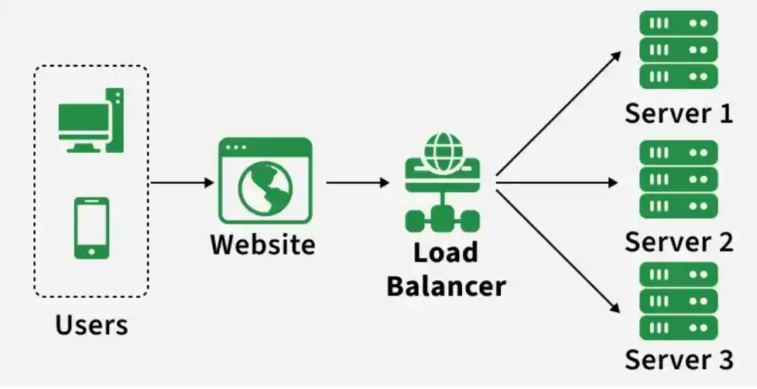

Slide 85
The Server Overload Problem and Solutions
When web traffic spikes, servers can easily become overloaded. There are two primary ways to solve this:
Single-Server Solution (Vertical Scaling/Upgrading): Upgrading the existing server to a higher-performance machine.
Drawback: Expensive and the new server may also eventually overload.
2. Multiple-Server Solution (Horizontal Scaling/Clustering): Building a scalable service system across a cluster of servers and distributing the traffic.
Advantage: Highly cost-effective and much more scalable.

Slide 86
Load Balancing
Load balancing is the method of distributing network traffic equally across a pool of resources that support an application.
Modern applications must process millions of users simultaneously and return the correct text, videos, images, and other data to each user in a fast and reliable manner.
To handle such high volumes of traffic, most applications have many resource servers with duplicate data between them.
A load balancer is a device that sits between the user and the server group and acts as an invisible facilitator, ensuring that all resource servers are used equally.

Slide 87
Application security
Load balancers come with built-in security features to add another layer of security to your internet applications. They are a useful tool to deal with distributed denial of service attacks, in which attackers flood an application server with millions of concurrent requests that cause server failure. Load balancers can also do the following:
Monitor traffic and block malicious content
Automatically redirect attack traffic to multiple backend servers to minimize impact
Route traffic through a group of network firewalls for additional security

Slide 88
Application performance
Load balancers improve application performance by increasing response time and reducing network latency. They perform several critical tasks such as the following:
Distribute the load evenly between servers to improve application performance
Redirect client requests to a geographically closer server to reduce latency
Ensure the reliability and performance of physical and virtual computing resources

Slide 89
What are load balancing algorithms?
A load balancing algorithm is the set of rules that a load balancer follows to determine the best server for each of the different client requests. Load balancing algorithms fall into two main categories.
Static load balancing
Static load balancing algorithms follow fixed rules and are independent of the current server state.
Dynamic load balancing
Dynamic load balancing algorithms examine the current state of the servers before distributing traffic

Slide 90
Static load balancing
The following are examples of static load balancing.
Round-robin method
Weighted round-robin method
IP hash method

Slide 91
Round-robin method
Servers have IP addresses that tell the client where to send requests. The IP address is a long number that is difficult to remember. To make it easy, a Domain Name System maps website names to servers. When you enter aws.amazon.com into your browser, the request first goes to our name server, which returns our IP address to your browser.
In the round-robin method, an authoritative name server does the load balancing instead of specialized hardware or software. The name server returns the IP addresses of different servers in the server farm turn by turn or in a round-robin fashion.

Slide 92
Weighted round-robin method
In weighted round-robin load balancing, you can assign different weights to each server based on their priority or capacity. Servers with higher weights will receive more incoming application traffic from the name server.
IP hash method
In the IP hash method, the load balancer performs a mathematical computation, called hashing, on the client IP address. It converts the client IP address to a number, which is then mapped to individual servers.

Slide 93
Dynamic load balancing
The following are some examples of dynamic load balancing algorithms.
Least connection method
Weighted least connection method
Least response time method
Resource-based method

Slide 94
Least connection method
A connection is an open communication channel between a client and a server. When the client sends the first request to the server, they authenticate and establish an active connection between each other. In the least connection method, the load balancer checks which servers have the fewest active connections and sends traffic to those servers. This method assumes that all connections require equal processing power for all servers.
Weighted least connection method
Weighted least connection algorithms assume that some servers can handle more active connections than others. Therefore, you can assign different weights or capacities to each server, and the load balancer sends the new client requests to the server with the least connections by capacity.

Slide 95
Least response time method
The response time is the total time that the server takes to process the incoming requests and send a response. The least response time method combines the server response time and the active connections to determine the best server. Load balancers use this algorithm to ensure faster service for all users.
Resource-based method
In the resource-based method, load balancers distribute traffic by analyzing the current server load. Specialized software called an agent runs on each server and calculates usage of server resources, such as its computing capacity and memory. Then, the load balancer checks the agent for sufficient free resources before distributing traffic to that server.

Slide 96
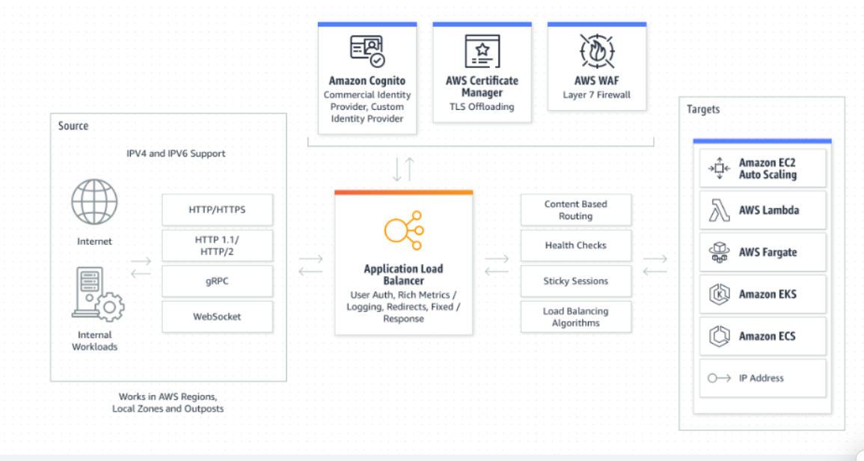
How does load balancing work?

Slide 97
Companies usually have their application running on multiple servers. Such a server arrangement is called a server farm. User requests to the application first go to the load balancer. The load balancer then routes each request to a single server in the server farm best suited to handle the request.
Load balancing is like the work done by a manager in a restaurant. Consider a restaurant with five waiters. If customers were allowed to choose their waiters, one or two waiters could be overloaded with work while the others are idle. To avoid this scenario, the restaurant manager assigns customers to the specific waiters who are best suited to serve them.

Slide 98
What are the types of load balancing?
We can classify load balancing into three main categories depending on what the load balancer checks in the client request to redirect the traffic.
Application load balancing
Network load balancing
Global Server load balancing
DNS load balancing

Slide 99
Application load balancing
Complex modern applications have several server farms with multiple servers dedicated to a single application function. Application load balancers look at the request content, such as HTTP headers or SSL session IDs, to redirect traffic.
For example, an ecommerce application has a product directory, shopping cart, and checkout functions. The application load balancer sends requests for browsing products to servers that contain images and videos but do not need to maintain open connections. By comparison, it sends shopping cart requests to servers that can maintain many client connections and save cart data for a long time.

Slide 100
Network load balancing
Network load balancers examine IP addresses and other network information to redirect traffic optimally. They track the source of the application traffic and can assign a static IP address to several servers. Network load balancers use the static and dynamic load balancing algorithms described earlier to balance server load.

Slide 101
Global server load balancing
Global server load balancing occurs across several geographically distributed servers. For example, companies can have servers in multiple data centers, in different countries, and in third-party cloud providers around the globe. In this case, local load balancers manage the application load within a region or zone. They attempt to redirect traffic to a server destination that is geographically closer to the client. They might redirect traffic to servers outside the client’s geographic zone only in case of server failure.

Slide 102
DNS load balancing
In DNS load balancing, you configure your domain to route network requests across a pool of resources on your domain. A domain can correspond to a website, a mail system, a print server, or another service that is made accessible through the internet. DNS load balancing is helpful for maintaining application availability and balancing network traffic across a globally distributed pool of resources.

Slide 103
What are the types of load balancing technology?
Load balancers are one of two types: hardware load balancer and software load balancer.
Hardware load balancers
A hardware-based load balancer is a hardware appliance that can securely process and redirect gigabytes of traffic to hundreds of different servers. You can store it in your data centers and use virtualization to create multiple digital or virtual load balancers that you can centrally manage.
Software load balancers
Software-based load balancers are applications that perform all load balancing functions. You can install them on any server or access them as a fully managed third-party service.

Slide 104
Comparison of hardware balancers to software load balancers
Hardware load balancers require an initial investment, configuration, and ongoing maintenance. You might also not use them to full capacity, especially if you purchase one only to handle peak-time traffic spikes. If traffic volume increases suddenly beyond its current capacity, this will affect users until you can purchase and set up another load balancer.
In contrast, software-based load balancers are much more flexible. They can scale up or down easily and are more compatible with modern cloud computing environments. They also cost less to set up, manage, and use over time.

Slide 105
Reference
https://aws.amazon.com/what-is/load-balancing/

Slide 106
Resource Allocation
The allocation of resources and services from a cloud provider to a customer is known as resource provisioning in cloud computing, sometimes called cloud provisioning. Resource provisioning is the process of choosing, deploying, and managing software (like load balancers and database server management systems) and hardware resources (including CPU, storage, and networks) to assure application performance.
To effectively utilize the resources without going against SLA and achieving the QoS requirements, Static Provisioning/Dynamic Provisioning and Static/Dynamic Allocation of resources must be established based on the application needs. Resource over and under-provisioning must be prevented.

Slide 107
Importance of Cloud Provisioning:
Scalability: Being able to actively scale up and down with flux in demand for resources is one of the major points of cloud computing
Speed: Users can quickly spin up multiple machines as per their usage without the need for an IT Administrator
Savings: Pay as you go model allows for enormous cost savings for users, it is facilitated by provisioning or removing resources according to the demand.

Slide 108
Challenges of Cloud Provisioning:
Complex management: Cloud providers have to use various different tools and techniques to actively monitor the usage of resources
Policy enforcement: Organisations have to ensure that users are not able to access the resources they shouldn't.
Cost: Due to automated provisioning costs may go very high if attention isn't paid to placing proper checks in place. Alerts about reaching the cost threshold are required.

Slide 109
Tools for Cloud Provisioning:
Google Cloud Deployment Manager
IBM Cloud Orchestrator
AWS CloudFormation
Microsoft Azure Resource Manager

Slide 110
Types of Cloud Provisioning:
Static Provisioning or Advance Provisioning:
Static provisioning can be used successfully for applications with known and typically constant demands or workloads. In this instance, the cloud provider allows the customer with a set number of resources. The client can thereafter utilize these resources as required. The client is in charge of making sure the resources aren't overutilized. This is an excellent choice for applications with stable and predictable needs or workloads. For instance, a customer might want to use a database server with a set quantity of CPU, RAM, and storage.

Slide 111
When a consumer contracts with a service provider for services, the supplier makes the necessary preparations before the service can begin. Either a one-time cost or a monthly fee is applied to the client. Resources are pre-allocated to customers by cloud service providers. This means that before consuming resources, a cloud user must select how much capacity they need in a static sense. Static provisioning may result in issues with over or under-provisioning.

Slide 112
Dynamic provisioning or On-demand provisioning:
With dynamic provisioning, the provider adds resources as needed and subtracts them as they are no longer required. It follows a pay-per-use model, i.e. the clients are billed only for the exact resources they use. Consumers must pay for each use of the resources that the cloud service provider allots to them as needed and when necessary. The pay-as-you-go model is another name for this.
"Dynamic provisioning" techniques allow VMs to be moved on-the-fly to new computing nodes within the cloud, in situations where demand by applications may change or vary. This is a suitable choice for programs with erratic and shifting demands or workloads. For instance, a customer might want to use a web server with a configurable quantity of CPU, memory, and storage. In this scenario, the client can utilize the resources as required and only pay for what is really used. The client is in charge of ensuring that the resources are not oversubscribed; otherwise, fees can skyrocket.

Slide 113
Self-service provisioning or user self-provisioning:
In user self-provisioning, sometimes referred to as cloud self-service, the customer uses a web form to acquire resources from the cloud provider, sets up a customer account, and pays with a credit card. Shortly after, resources are made accessible for consumer use.

